Slide 1
Enabling Digital Inclusion in Renfrewshire
Renfrewshire Wellbeing Network
Wednesday 29 January 2025
Ross McNicol / James McKee – Renfrewshire Council

Slide 2
A great way to meet with around 190 individuals representing 70+ unique local and national organisations covering:
Public Sector
Third, Community, Charity, Voluntary Sector
Business Sector
Social Housing Sector
Academia Sector
An opportunity to collaborate, learn and share best practice with the aim of promoting digital inclusion opportunities.

Slide 3
Citizens Voice Forum: co-designing digital inclusion solutions by working with organisations involved in delivering digital inclusion as well as those impacted by digital exclusion
Digital Champions Programme (Renfrewshire Libraries – ONEREN)
2-year funding secured (2023)
Supported over 800 learners across 6 libraries
Issued over 160 preloaded data sims
Built a team of dedicated Digital Champion volunteers Delivered over 1,150 vol. hours.

Slide 4
Citizens Voice Forum: co-designing digital inclusion solutions by working with organisations involved in delivering digital inclusion as well as those impacted by digital exclusion
Digizones
Connect, Learn, Explore
21 DigiZones and Mobile DigiZone launched across Renfrewshire
Community-Led Secure Device Recycling Initiative
Renfrewshire Recycle IT

Slide 5
Enabling Digital Inclusion

Slide 6
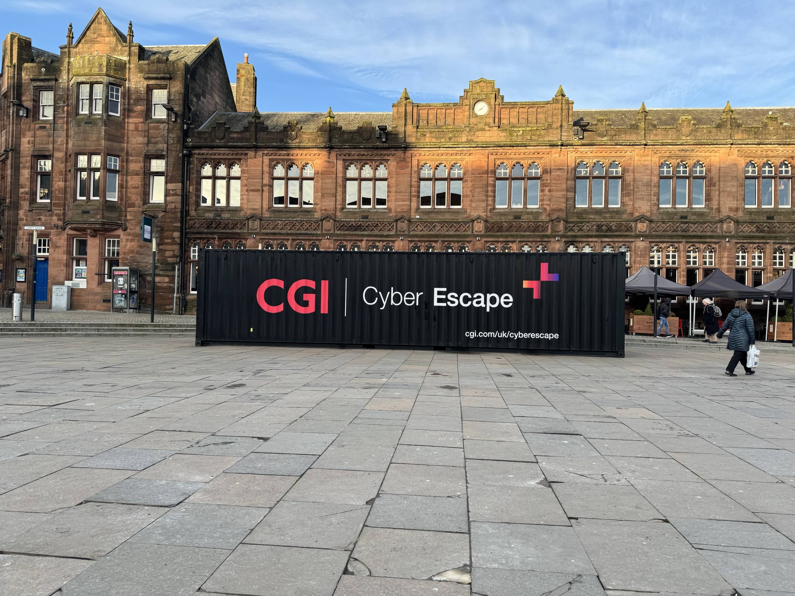
Keeping People Safe, Confident and Protected Online RenSafeOnline
PRIMARY MISSION
“To support Renfrewshire Council's aspirations by taking a hyperlocal and place-based approach using byte-sized messaging"
Established 2019 in partnership with Get Safe Online
Initially to deliver online safety training for community based mental health employees
Available to anyone living, learning or working in Renfrewshire
BENEFITS
Builds confidence, capacity & resilience
Greater awareness of online scams and harms
Understand the importance of various layers to protect people
Enables Ambassadors to have sensitive, caring and empathetic conversations with victims or potential victims of online harm
ACHIEVEMENTS
Over 160 Online Safety Ambassadors
Monthly focussed campaigns
Prevention / success stories
Cyber Escape Room…

Slide 7
QUESTION?
Where do people go to learn new or develop their Digital Skills?

Slide 8
Building Confidence, Capacity and Capability through Digital Skills
LOCAL
NATIONAL
Digital Champions Programme (ONEREN)
Digital Champions Network (Niche Academy)
DigiZones
Digital College (Invest in Renfrewshire)
RenSafeOnline
Budding Engineers
DWP / JCP
Paisley YMCA
Renfrew YMCA
Renfrewshire Council – CLD
Roar – Connections for Life
Barclays Digital Eagles / Digital Wings Platform
Connecting Scotland Digital Champions
Google Garage
Inspiring Digital Enterprise Award (iDEA)
Mhor Collective
Microsoft Digital Skills Hub
My Computer My Way (AbilityNet)
My World of Work (SDS)
SCVO Essential Digital Skills Check-up

Slide 9
QUESTION?
Where do people go to access a digital device?

Slide 10
Device Access
LOCAL
NATIONAL
Community-Led Securing Device Recycling Project (in progress)
DigiZones
DWP / JCP
Paisley YMCA
Renfrewshire HSCP – Disability Resource Centre
Renfrewshire Libraries – Device Lending Scheme
West College Scotland – Device Lending Scheme
Invest in Renfrewshire
Connecting Scotland*
Connecting U (AbilityNet)*
National Device Recycling Schemes
The Good Things Foundation (National Device Bank)
*Subject to availability

Slide 11
QUESTION?
Where do people go to access the internet?

Slide 12
Internet Access (Connectivity)
LOCAL
NATIONAL
DigiZones
Public Access WI-FI Points – up to 180 across Renfrewshire and in 3 town centres
Engage Renfrewshire
Sky UP Hub (Active Communities)
DWP / JCP
UWS
Paisley YMCA
Renfrew YMCA
Renfrewshire HSCP venues
Roar – Connections for Life
The Good Things Foundation (National Data Bank)
Your SimPal
Charities Connected
ATP Enable – Secure Sim Cards
Digital Poverty Alliance
AbilityNet*
Broadband Social Tariffs
Input Community Works
*Subject to availability

Slide 13
Examples of Digital Inclusion in Action

Slide 14
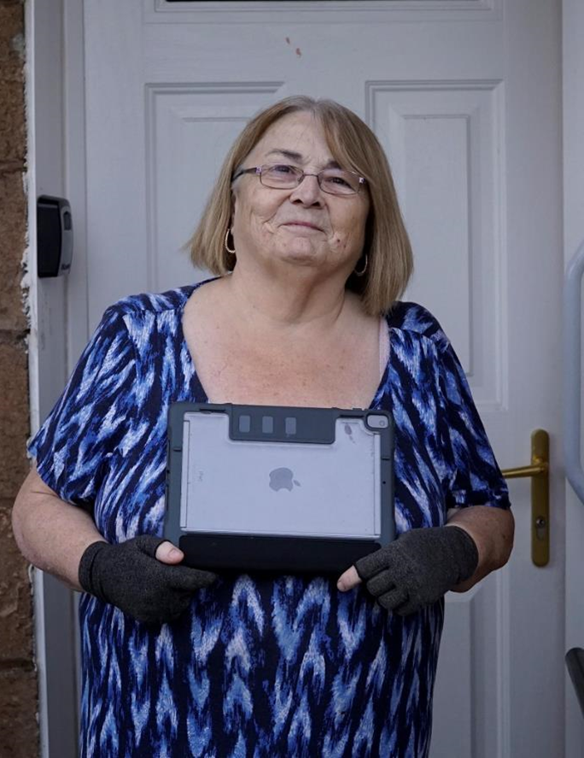
Stories of Digital Inclusion
Lorraine needed a device to get
online during the pandemic
Lorraine has physical impairments
which means using technology can be difficult,
and getting out to shop can be a challenge.
With a Connecting Scotland iPad, Lorraine was able to keep in touch with family and friends, and importantly it was the only way she could see her newly arrived grandson, born overseas, due to the travel restrictions.
It provided her with a lifeline back to the community and allowed her to purchase the things she needed.

Slide 15
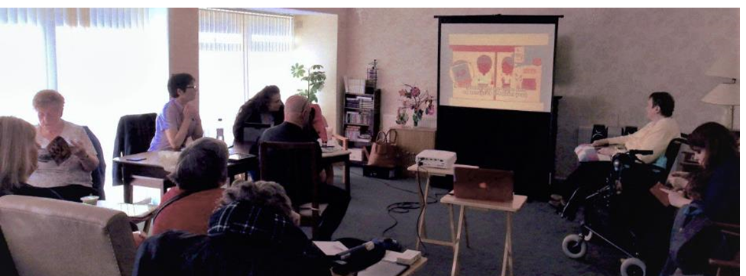
Stories of Digital Inclusion

Slide 16
What’s Next
DigiRen
8 weekly catch-ups
Programme of inspiring speakers
DigiRen Directory
DigiKnowVember
Annual Impact Report
Analogue to Digital Switchover Webinar
RenSafeOnline
Monthly campaigns on online safety
Online Safety Ambassador recruitment
Citizens Voice Forum
DigiZones – evaluation and further rollout
Digital Champions – secure funding and expand provision
Device Recycling – develop a planned and coordinated approach in partnership with local organisation.

Slide 17
Want to get involved? / Useful Resources (select link(s) below)
Become a volunteer Digital Champion with Renfrewshire Libraries
Join DigiRen Network
Become an active member and support Citizens Voice Forum
Become an Online Safety Ambassador
Get Safe Online – Self Help Centre

Slide 18
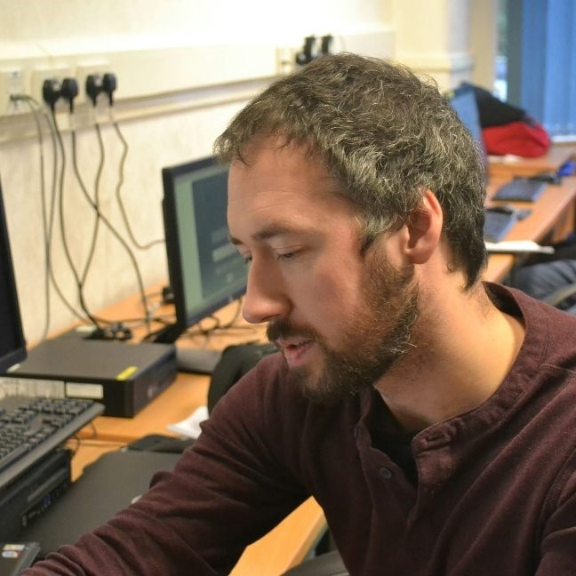
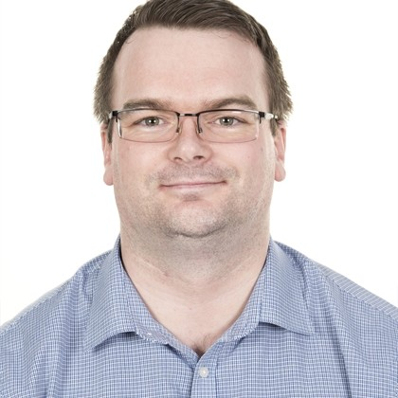
Thank You
Robert Ross McNicol
Digital Participation Officer
Renfrewshire Council
E: ross.mcnicol@renfrewshire.gov.uk
James McKee
Digital Strategy Delivery Manager
Renfrewshire Council
E: james.mcKee@renfrewshire.gov.uk

